Slide 1

Complete ASIC Flow of I2C communication protocol

Slide 2
Submitted by
Hayat Gamal
Aya Reda Osman
Hadeer Khaled
Fatma Abdelmonsef

Slide 3
Project Description
I2C is a two wire serial communication protocol using a serial data line (SDA) and a serial clock line (SCL)
The I2C standard is a true multi-master bus including collision detection and arbitration that prevents data corruption if two or more masters attempt to control the bus simultaneously
In this project, I will go through the ASIC flow to create the complete layout (GDS) of an I2C which is a two-wire, Using SAED90_EDK

Slide 4
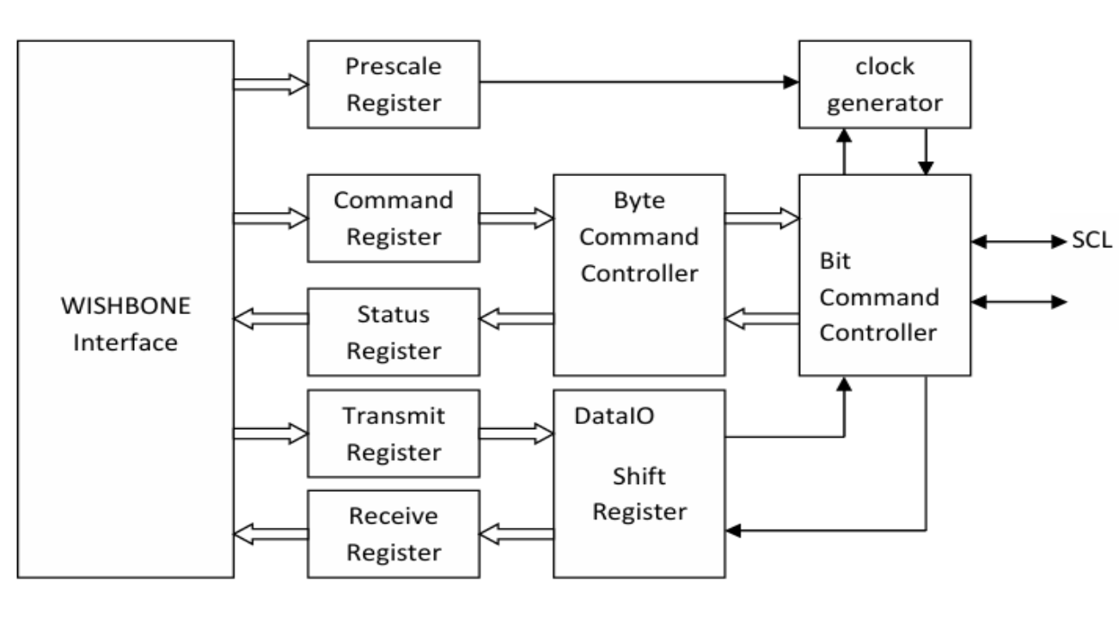
Internal structure of I2C

Slide 5
Content:
Synthesis of the code
Timing analysis
Formal Verification
Floor Planning
Power planning
Clock tree synthesis (CTS)
Placing and routing
Final layout & Signoff

Slide 6
EDA Tools
Design Compiler (DC)
Formality
IC Compiler II
PrimeTime
IC Compiler II Library Manager

Slide 7
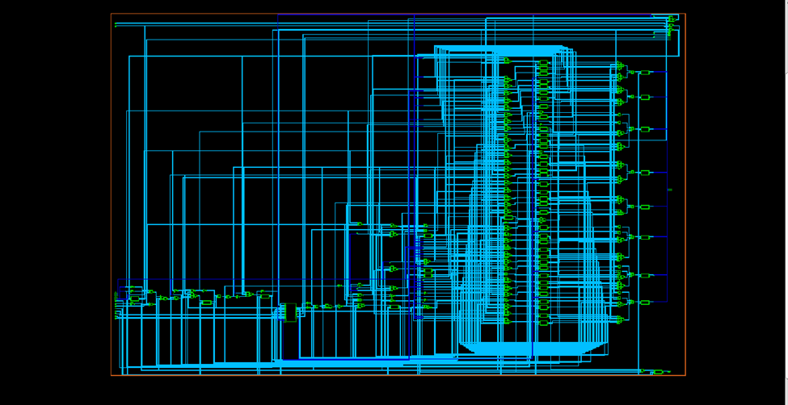
Schematic view of Synthesis netlist

Slide 8
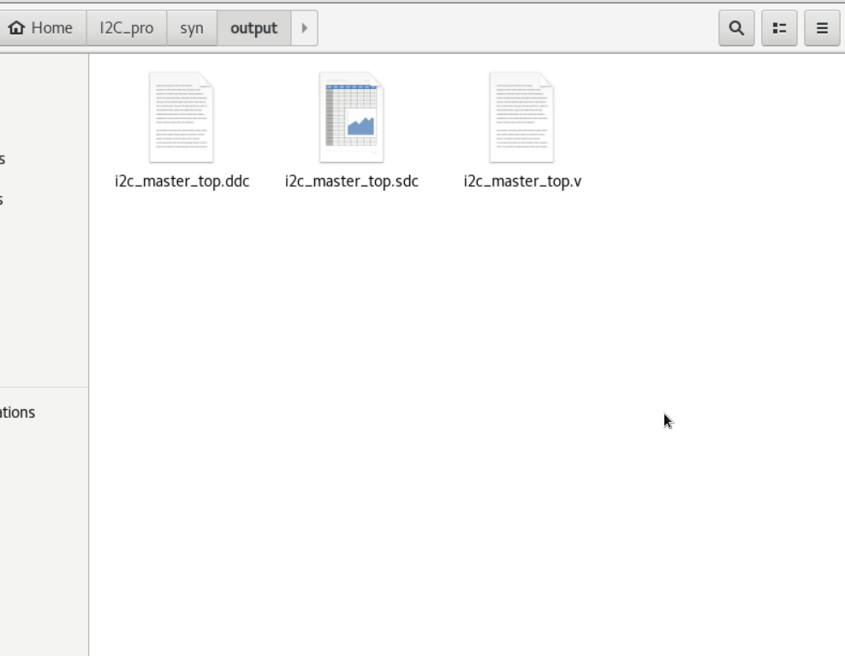
Synthesis Output files

Slide 9
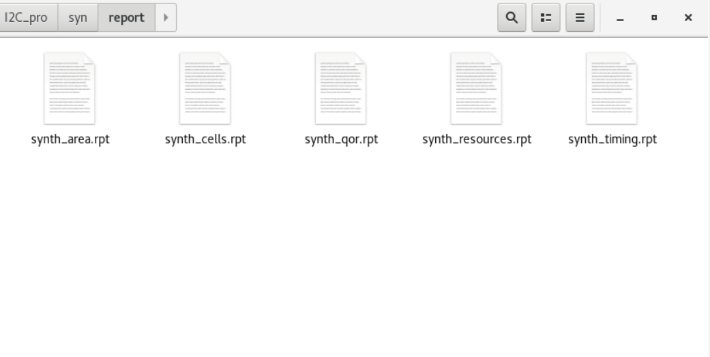
Synthesis Report files

Slide 10
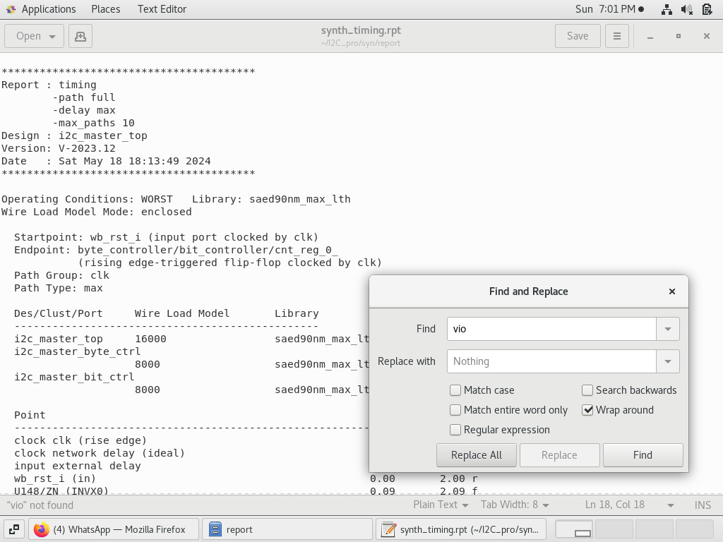
Synthesis Timing report

Slide 11
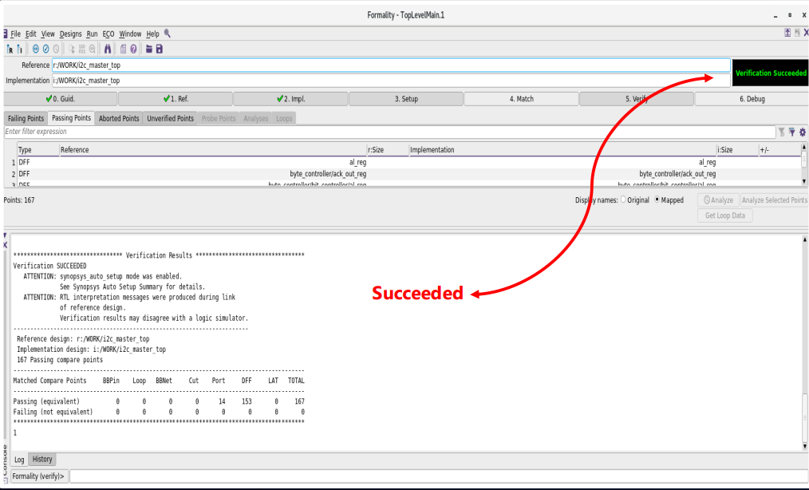
Result of Formal Verification

Slide 12
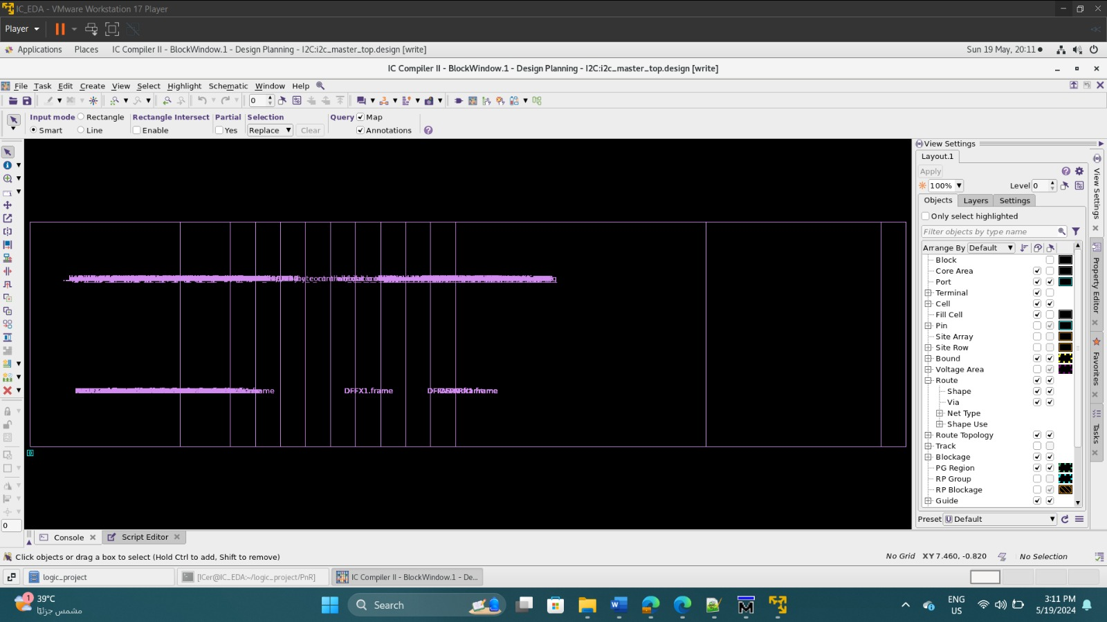
Floor planning before sizing

Slide 13
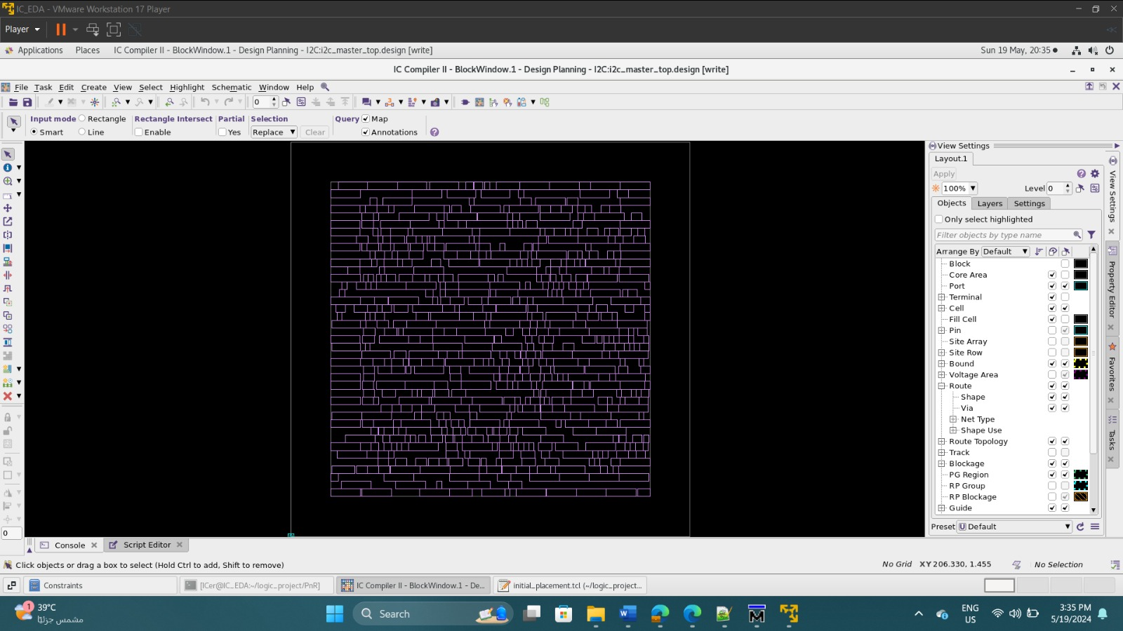
Initial Floor planning

Slide 14

Pin Placement

Slide 15
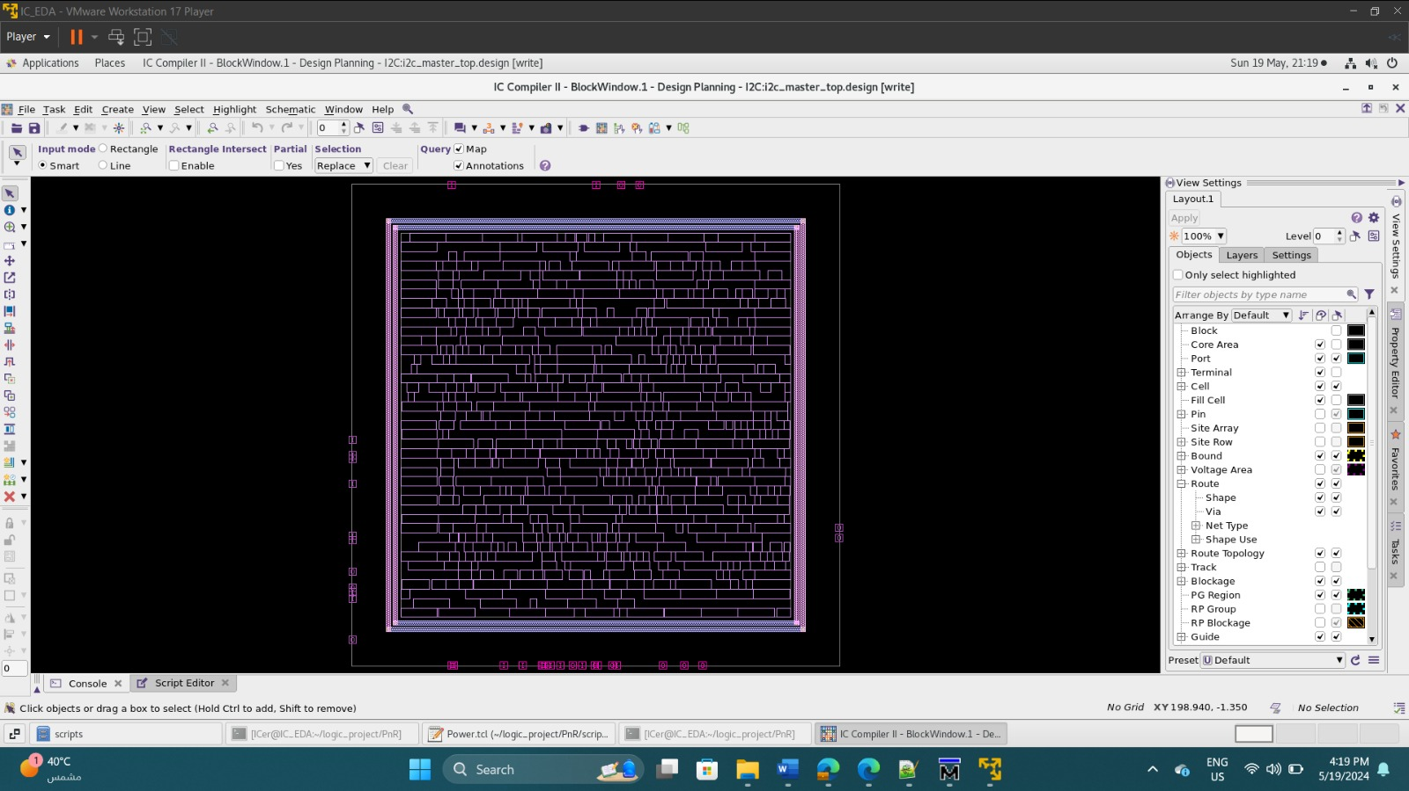
Power planning (Ring)

Slide 16
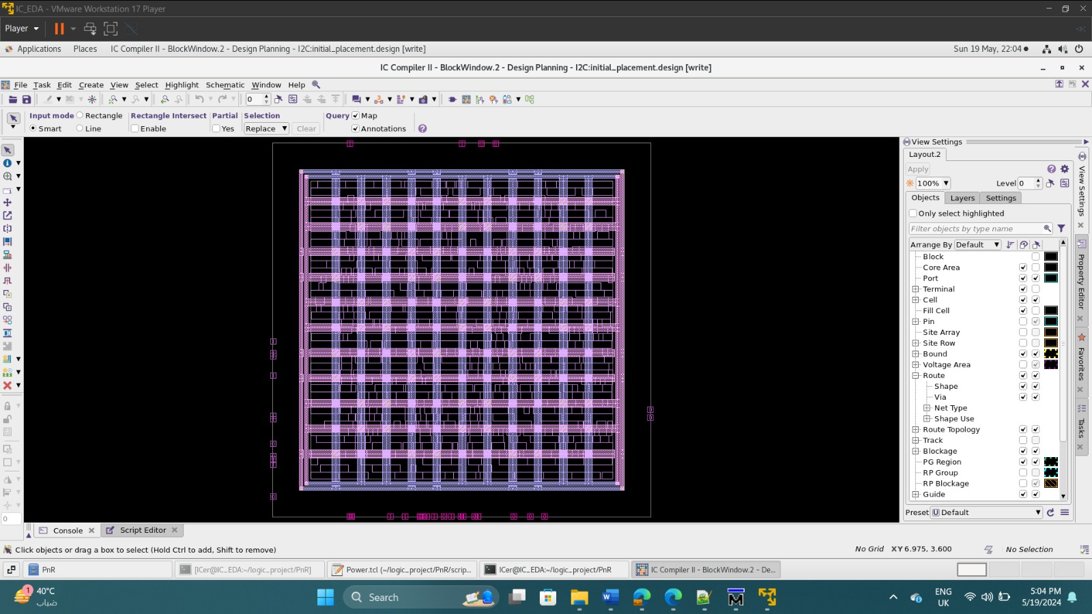
Power planning (Mesh)

Slide 17
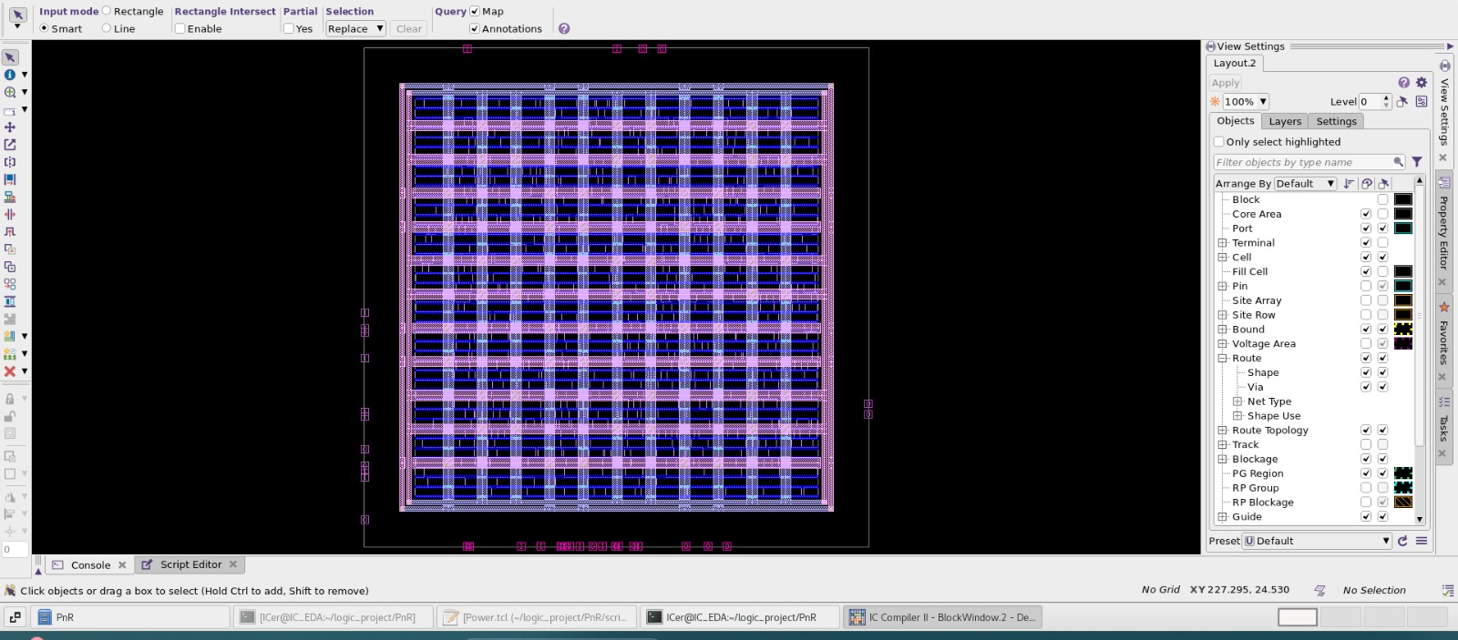
Power Planning after standard cell rail insertion

Slide 18
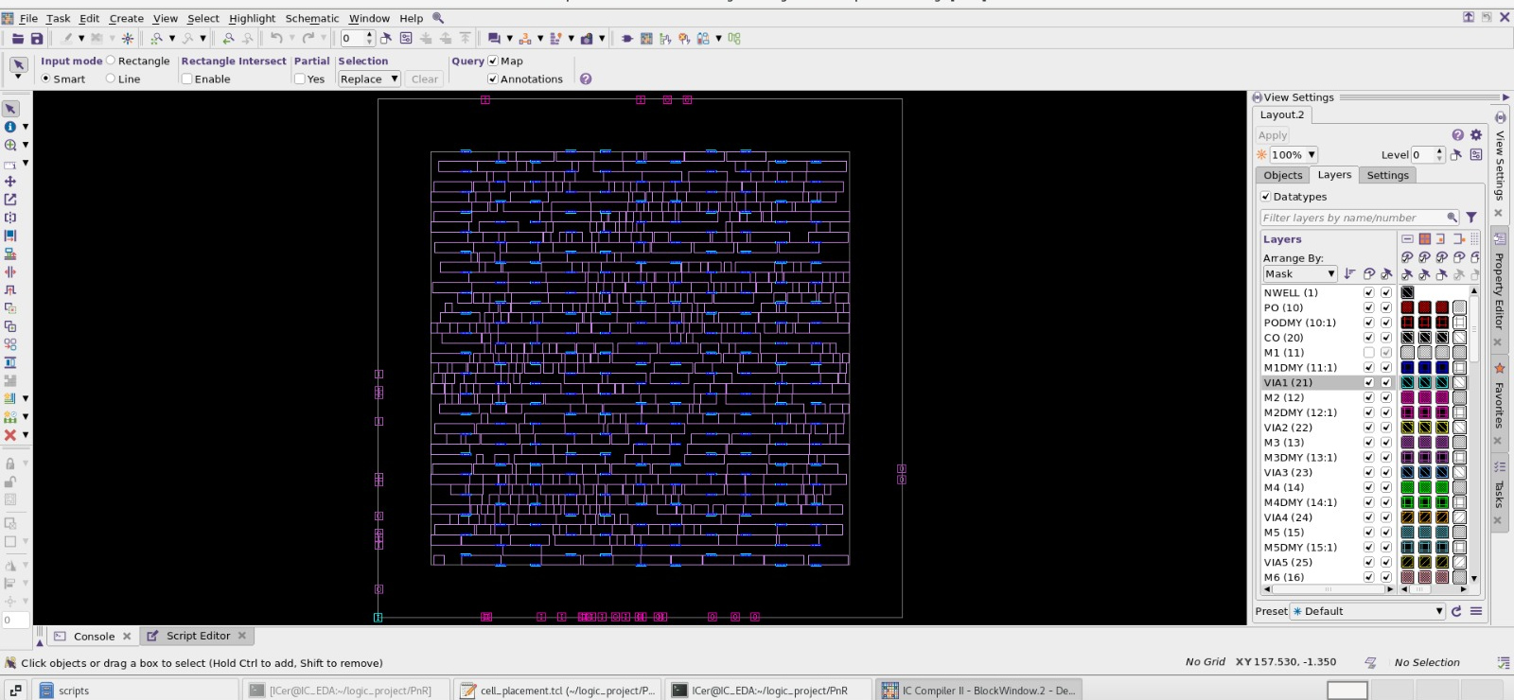
Cell Placement optimization with legalization

Slide 19
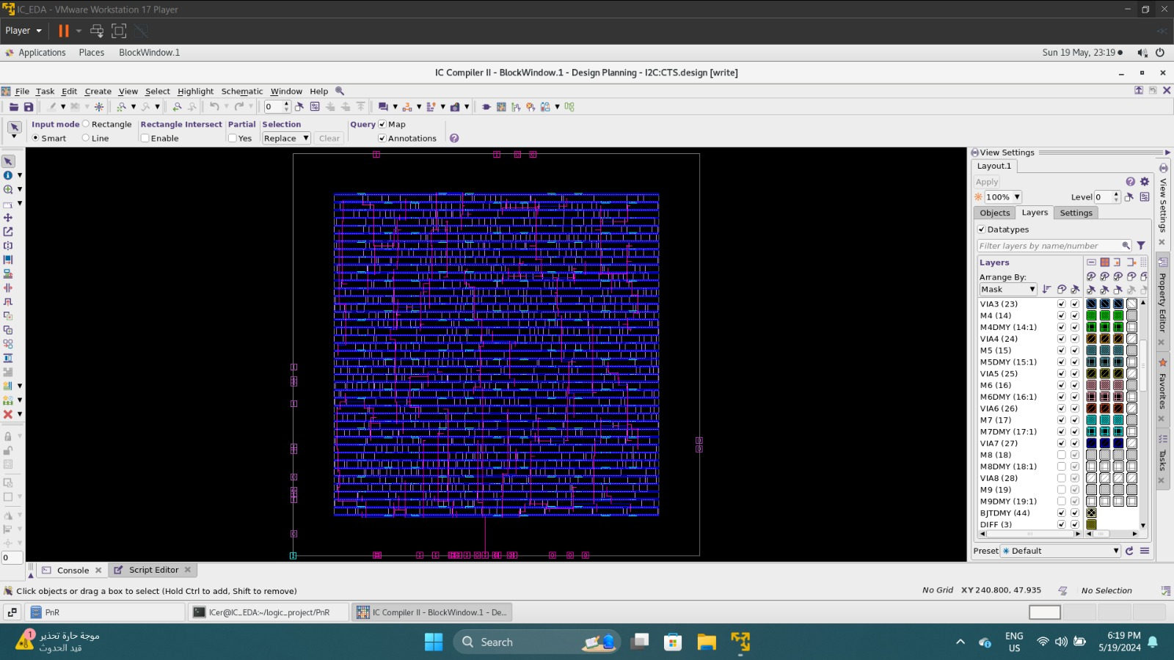
CTS (Clock Tree Synthesis)

Slide 20
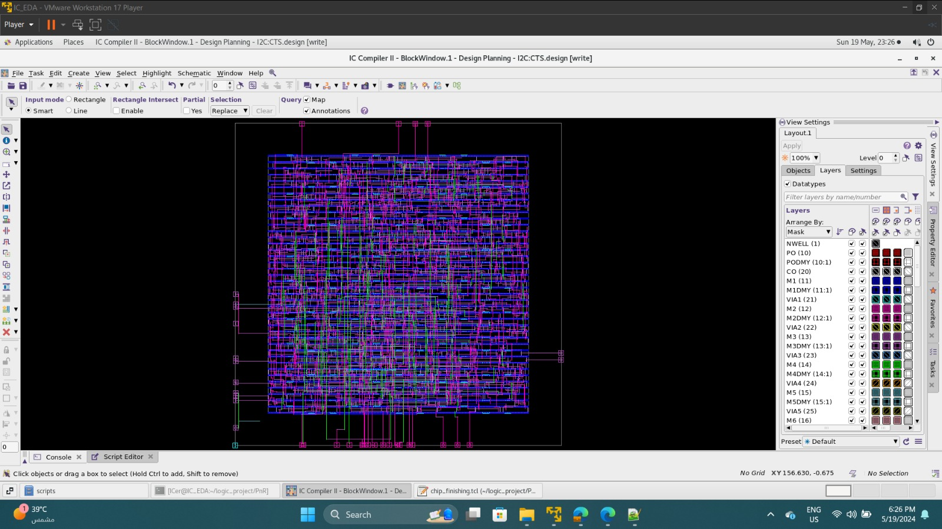
Routing & Routing Optimization

Slide 21
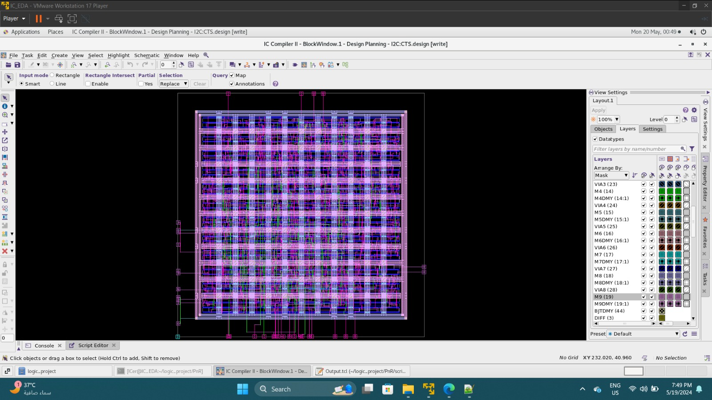
Adding Filler Cells

Slide 22
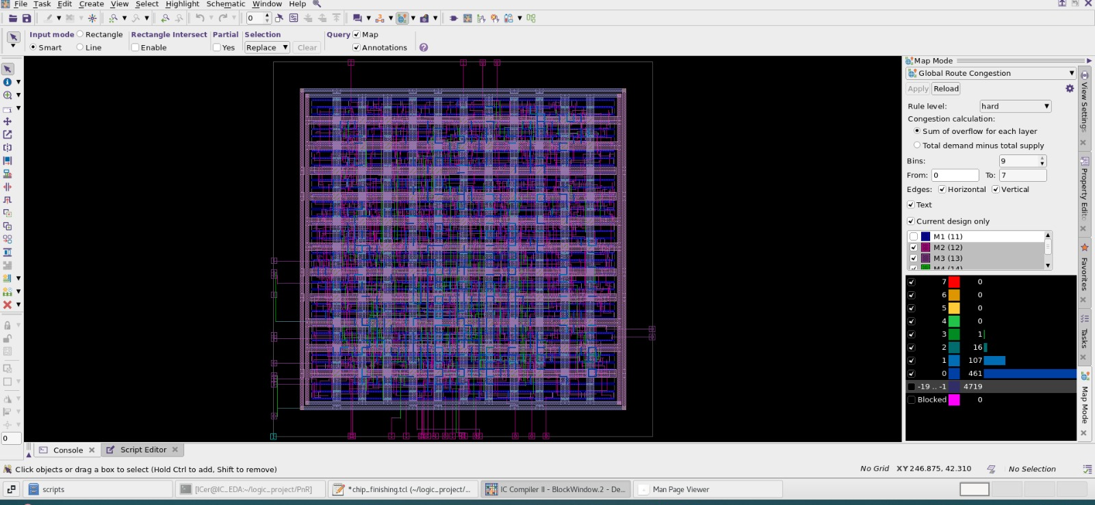
Global Route Congestion Map

Slide 23
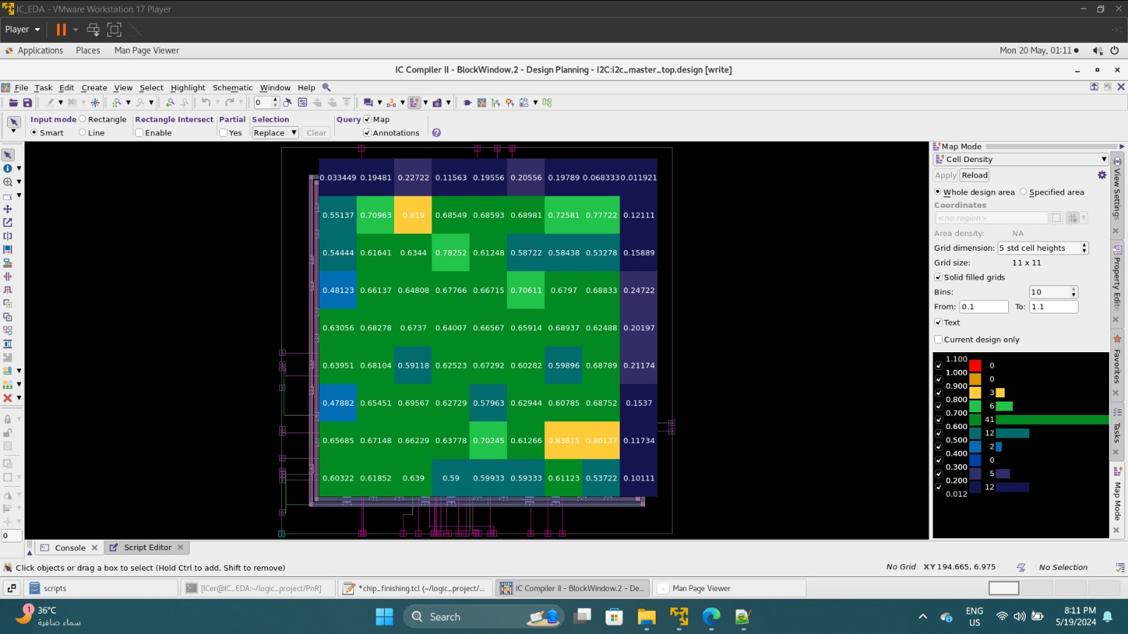
Cell Density

Slide 24
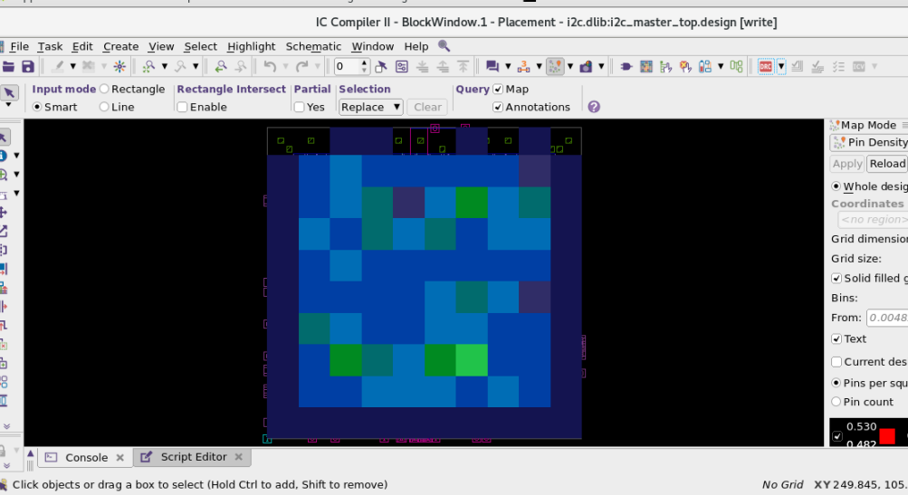
Pin Density

Slide 25
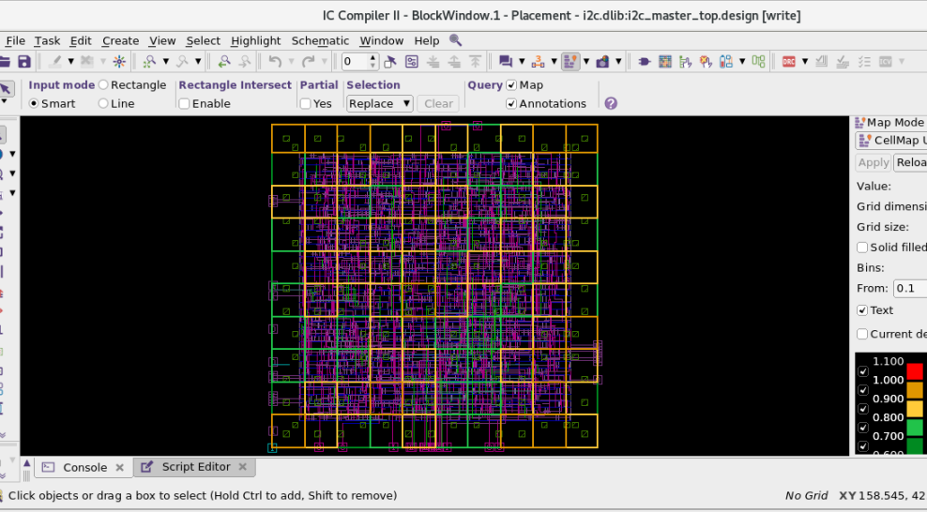
Cell Map Utilization

Slide 26
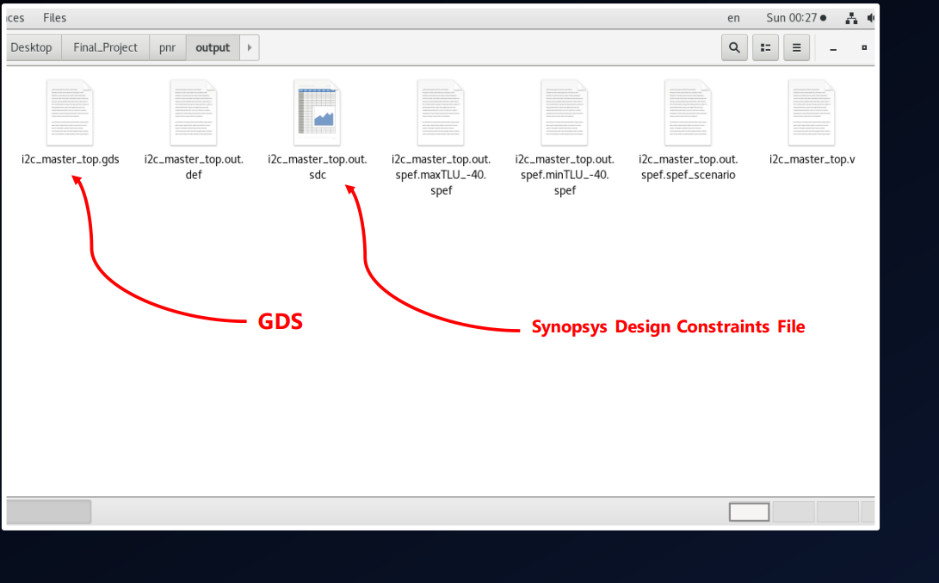
ICC II Output Files

Slide 27
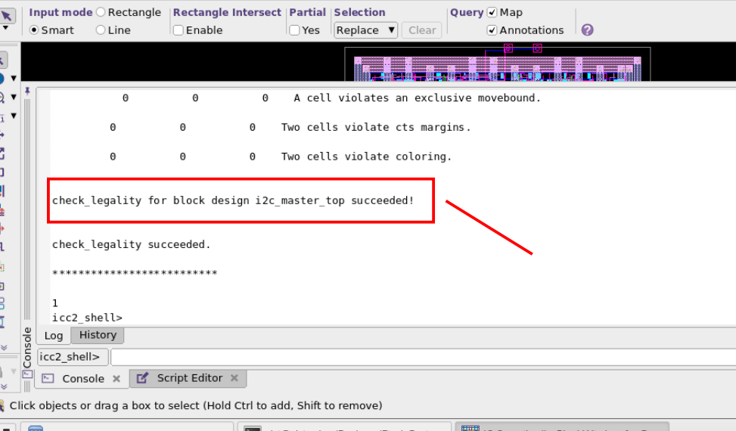
Legality Check

Slide 28
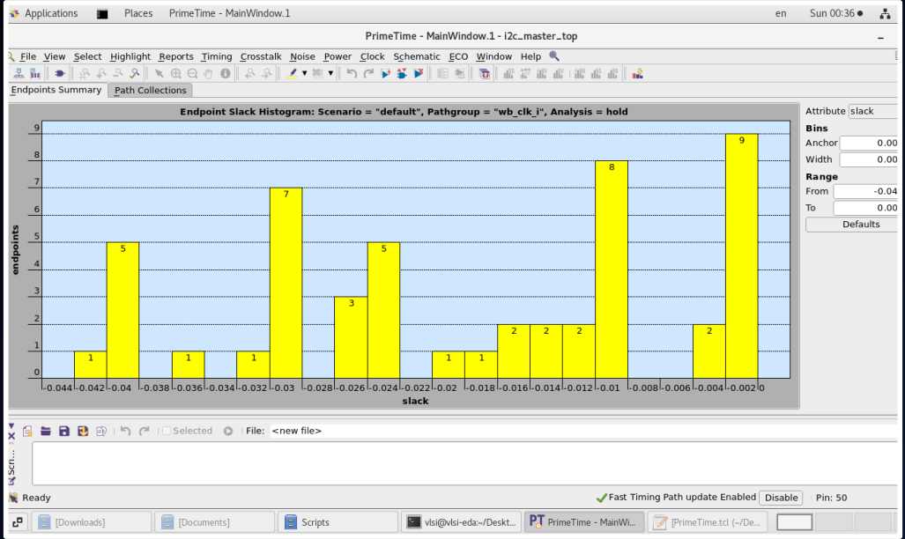
Primetime Histogram

Slide 29
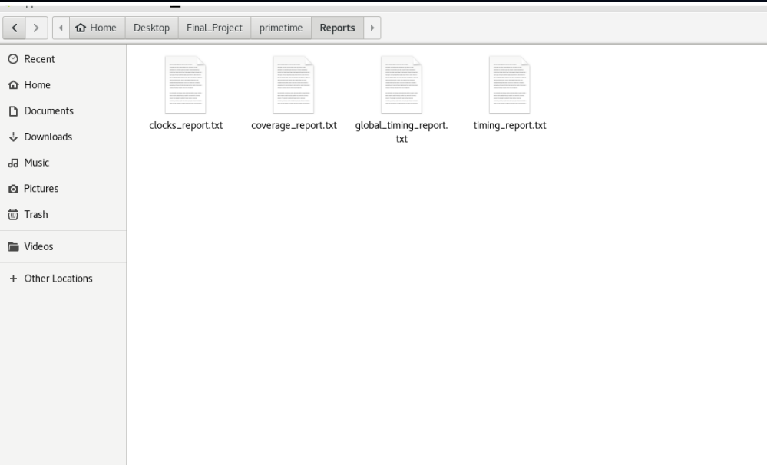
Primetime Reports

Slide 30
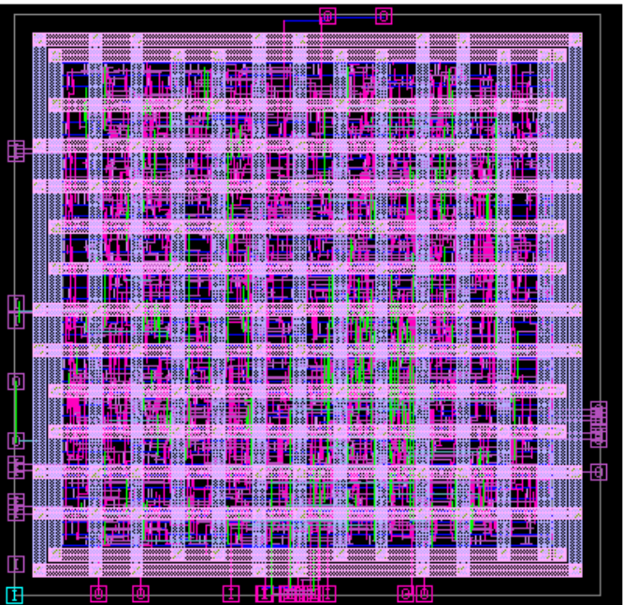
Final Layout

